Slide 1
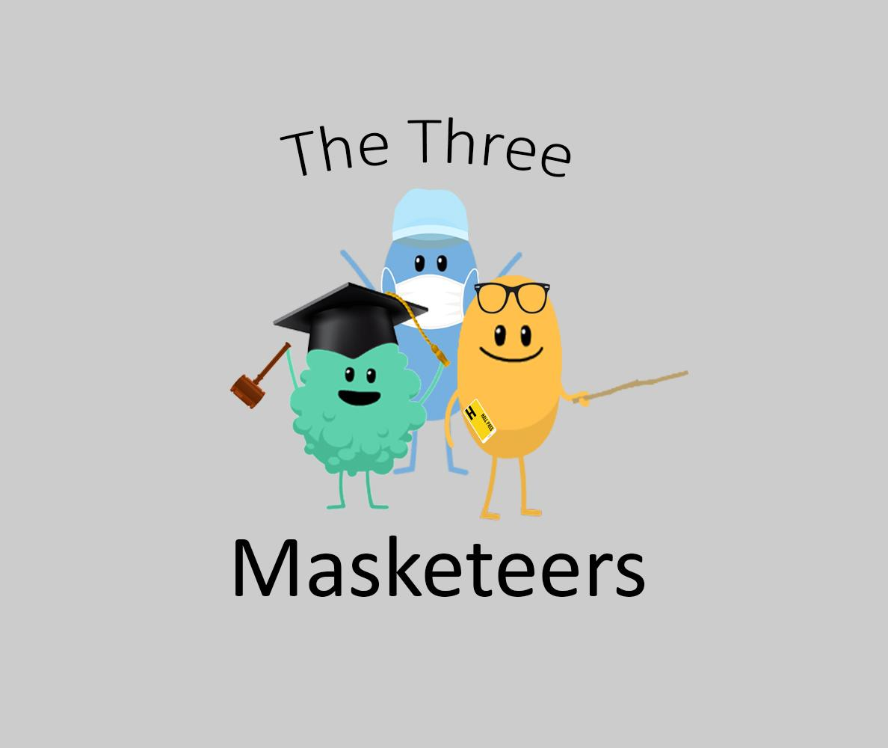
By Yeeeet

Slide 2
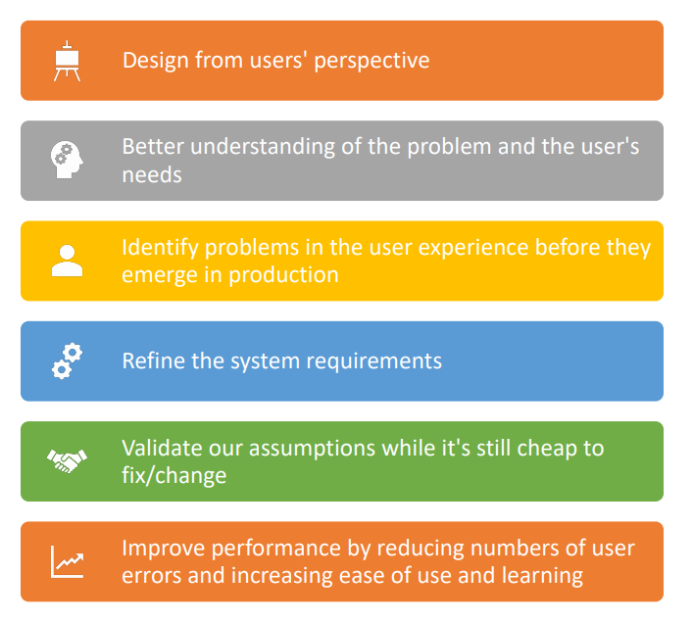
Why is User Centric Design Important?

Slide 3
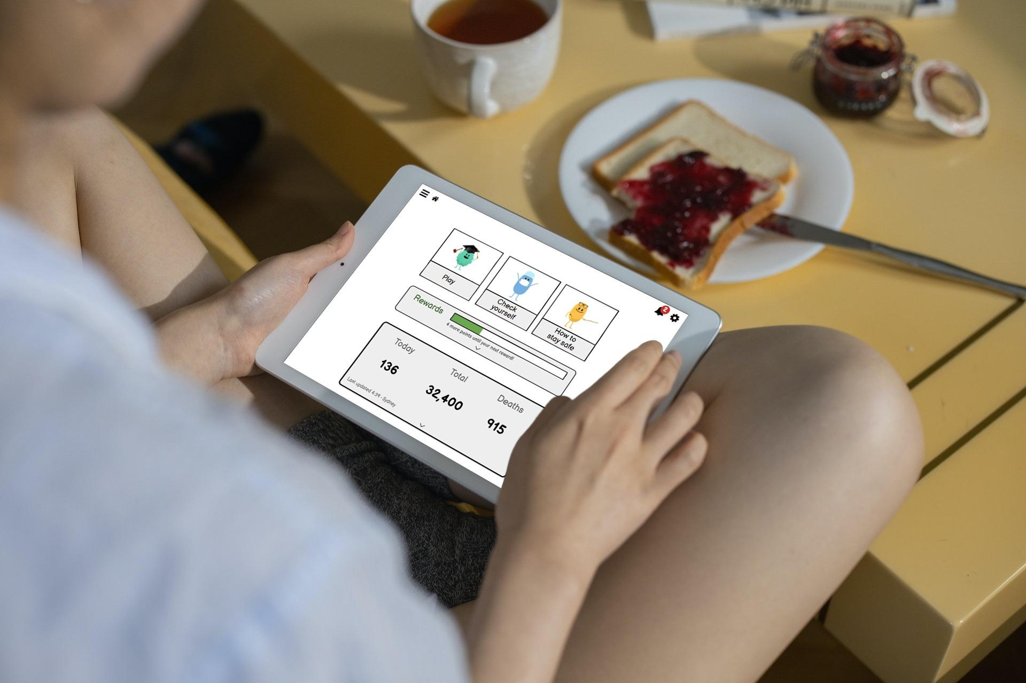
Product Demo

Slide 4
Issues table
SEVERITY SCALE:
1 - Cosmetic Issue 2 - Minor Issue 3 - Major Issue 4 - Showstopper

Slide 5
SEVERITY SCALE: 1 - Cosmetic Issue 2 - Minor Issue 3 - Major Issue 4 - Showstopper
Issue No | Description of issue | Changes made | Severity of issue (out of 4)
1. | Covid questionnaire provided poor grouping that was confusing and not aesthetically appealing. | Iterated on the design of the backdrop components and applied design throughout the page. | 3
2. | Covid questionnaire was initially confusing for users to use. | Added a work example by showing a video of how to use the application in a modal popup. | 2
3. | Covid laws page was cluttered and caused users to have a hard time processing all the information on the page. | Removed redundant text that was covered in the video/map and reworked map component. | 3
4. | Difficult to see player coins and no feedback for buying items | Changed design to improve split attention effect improve visibility of the user’s coins and added feedback to ‘buy’ button | 3
5. | Cognitive Overload when Images are presented to the user. Additionally the grouping of the images it difficult for users vision impairments to grasp the content | Introduced voice over, using modality reduced the cognitive load | 2
6. | Users Didn’t understand how to play some of the games | Introduced Instructions and Goals in the Pause Menu | 3
7. | Notification was difficult to read due to poor grouping. | Reworked design to provide better indication of the severity of notification and grouping of information. | 2

Slide 6
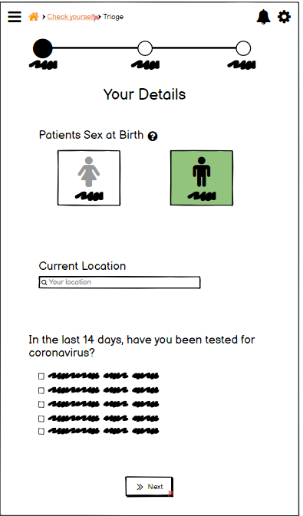
Issue #1 Covid questionnaire provided poor grouping was confusing.
Issues:
Poor grouping
Efficiency
Not aesthetically pleasing
Severity: 3

Slide 7
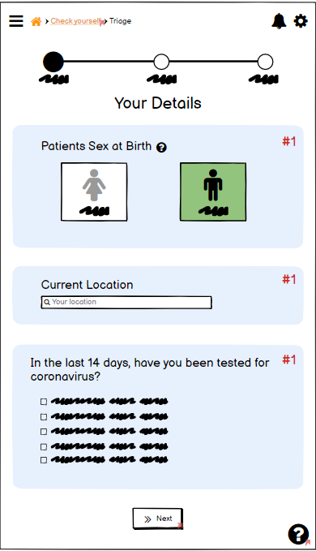
Issue #1 Covid questionnaire provided poor grouping was confusing.

Slide 8
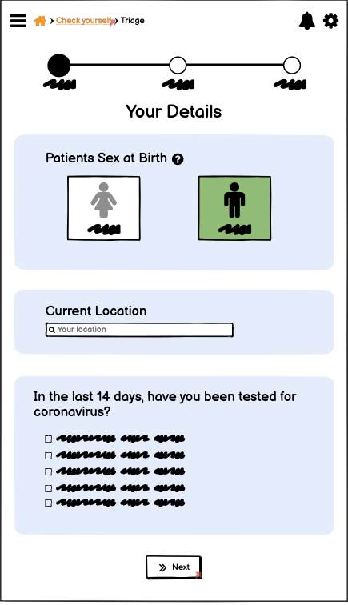
Issue #2: Covid questionnaire was confusing for novices.
Issues:
Overwhelming amount of elements.
No worked examples.
Severity: 2

Slide 9
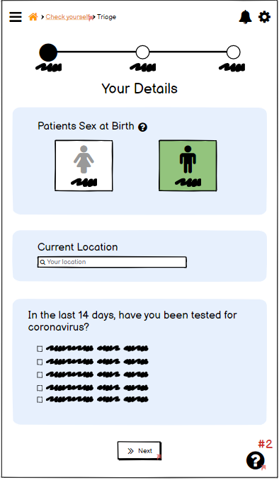
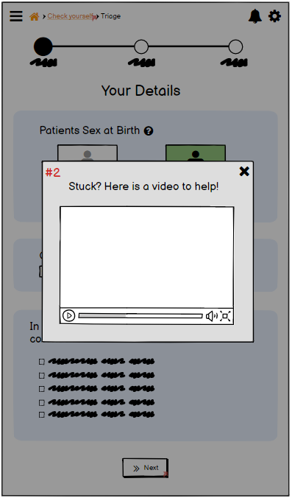
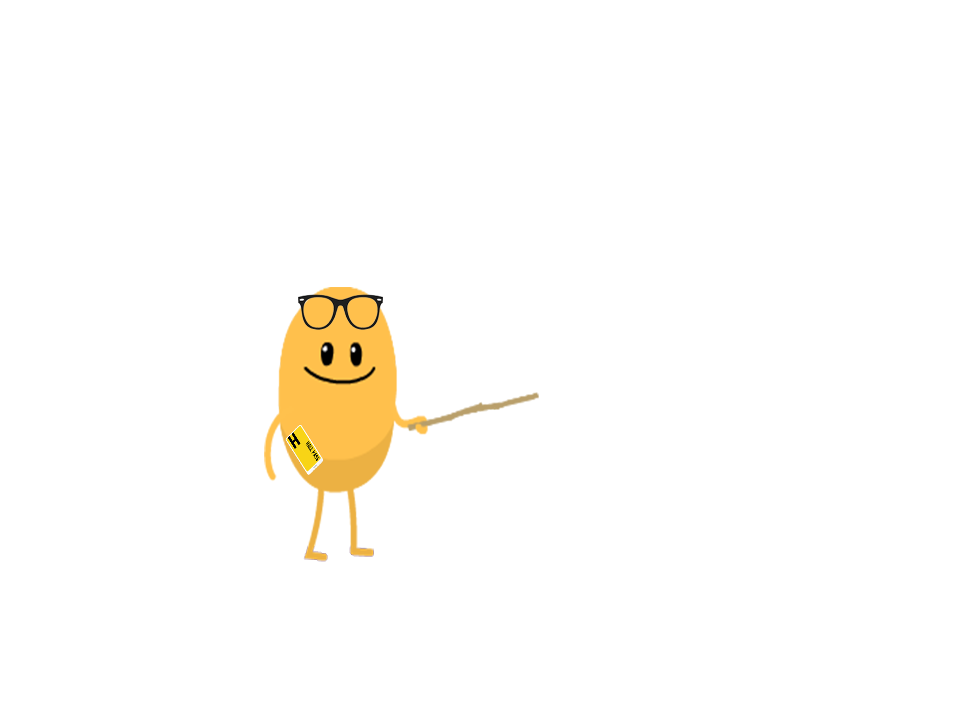
Issue #2: Covid questionnaire was confusing for novices.

Slide 10
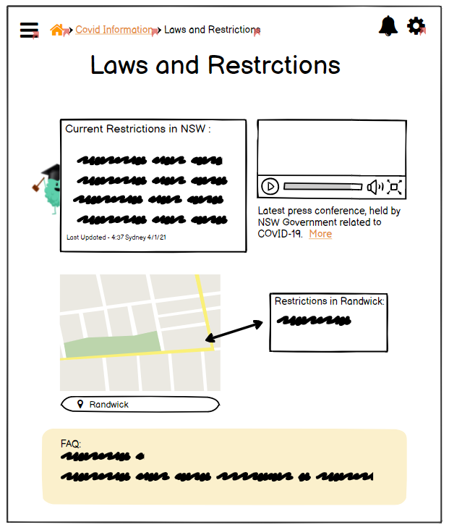

Issue 3: Covid laws
Issue:
Redundant information
Split attention effect
Inefficient
Severity: 3

Slide 11
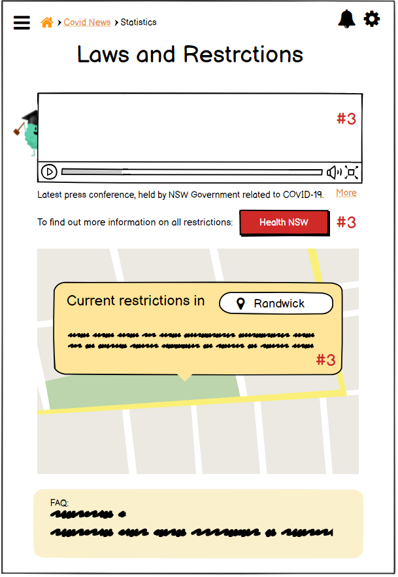
Issue 3: Covid laws

Slide 12

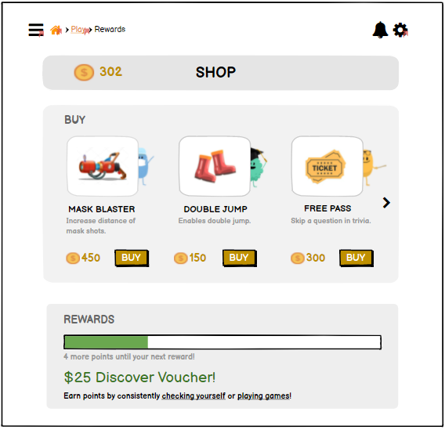
Issue 4: Shop
Issue:
Split attention effect
Feedback
Severity: 2

Slide 13
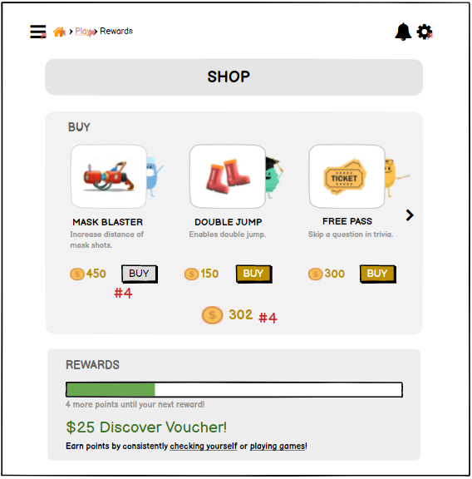
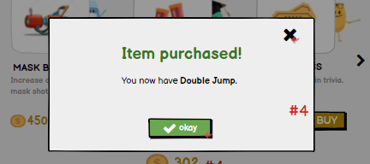
Issue 4: Shop

Slide 14
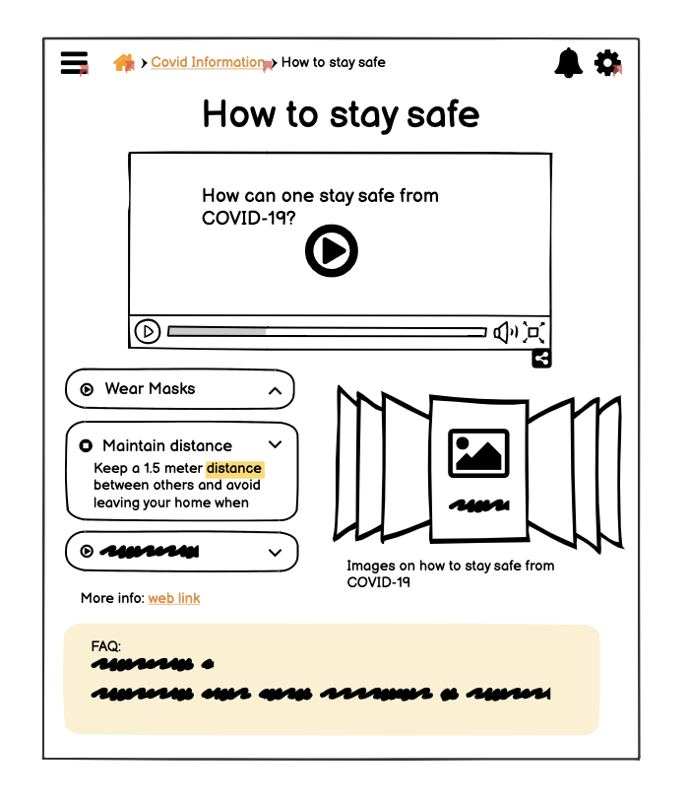
Issue 5: How to stay safe
Issue:
Cognitive Overload
Users with vision impairments
Severity: 2

Slide 15
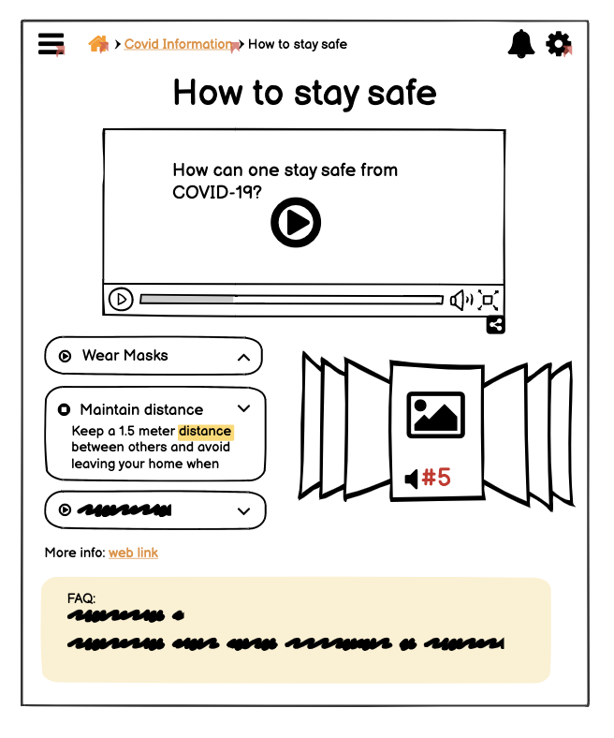
Issue 5: How to stay safe

Slide 16
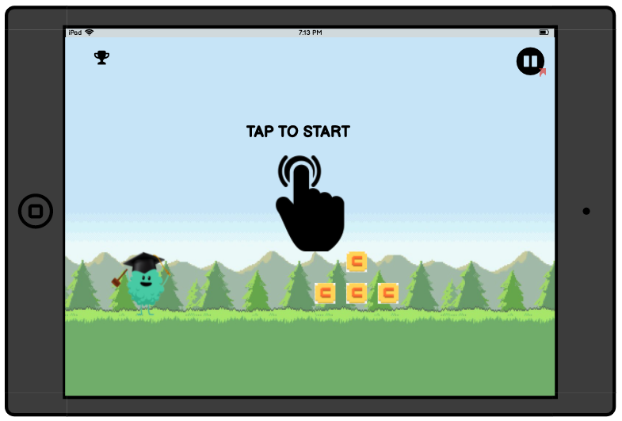
Issue #6: GAMES??
Issue:
Novice Users are Different From Expert Users
Users Might not Understand how to Play a Game
Severity: 3

Slide 17
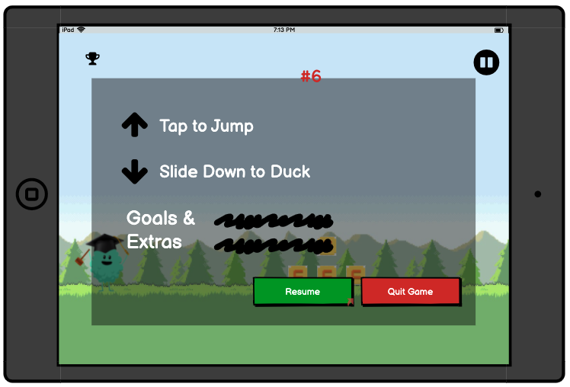
Issue #6: GAME??

Slide 18
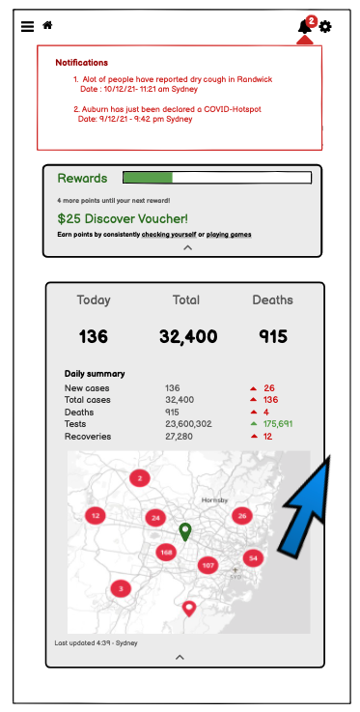
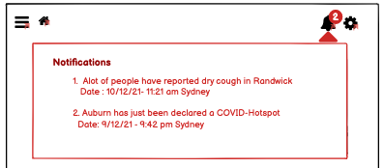
Issue #7: Notifications
Issue:
Very Difficult to Read
Poor Grouping
Not Analogous in Design
Severity: 2

Slide 19
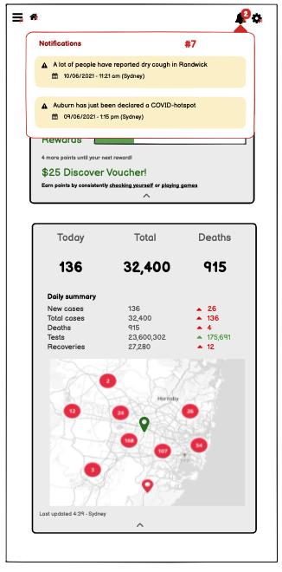
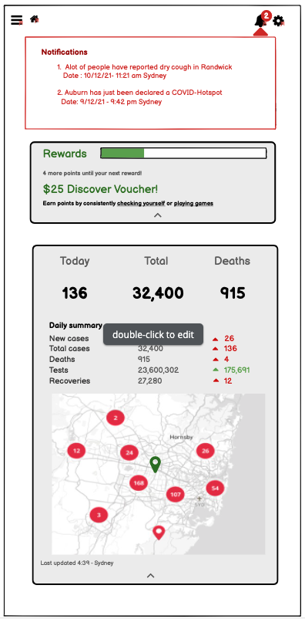
Issue #7: Notifications

Slide 20
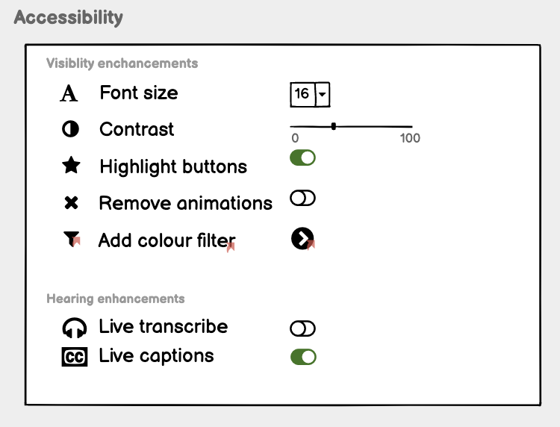
Accessibility
Vision Impairment - 18.8%
No accessibility need - 80%
Users still preferred to use accessibility features

Slide 21
The issue
Users recorded to take ~1-2 seconds to process the screen before answer questions.
The grouping on this page was terrible.
We lacked a way to logically group related issues throughout the app.

Slide 22
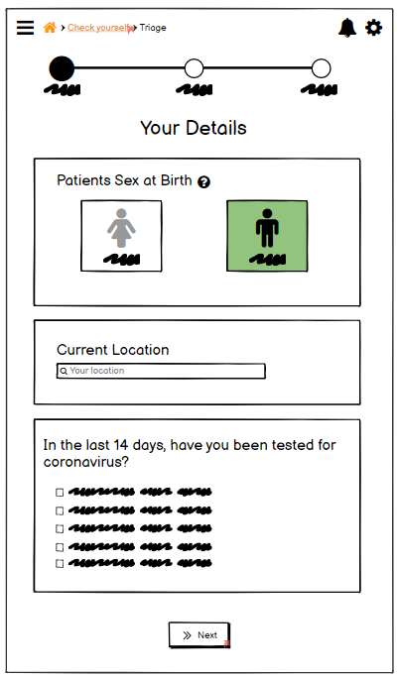
The ‘fix’
“Put a box around it”
Too blocky and hard to differentiate between questions and box groups.
4/9 users preferred the initial design over this one.
This iteration was a failure.

Slide 23
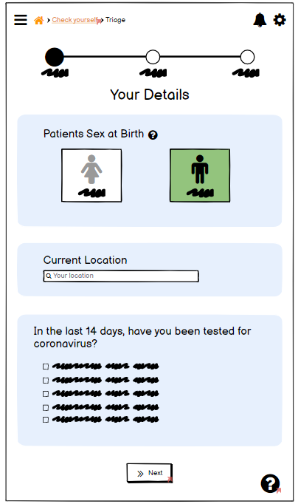
The actual fix
‘Put a box around it v2’
Grouping achieved by rounded coloured backdrop.
Very positive feedback from the users.

Slide 25
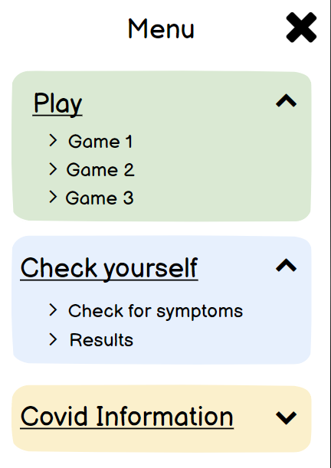
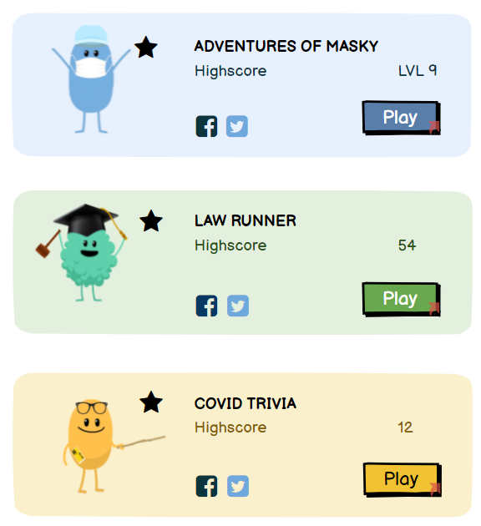
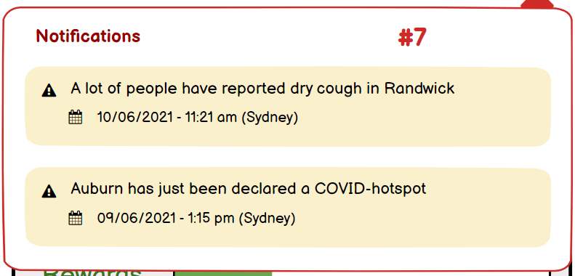
The results
User approved and tested concept.
Reused concept throughout the app.
Consistent and pleasurable user experience.

Slide 26
Our reflection
Pros/cons of solving problems in a group
Each person brings in something new
People may have clashing preferences
The takeaways of doing this course
Users, Users, Users! Importance of users into every stop of the design process.

Slide 27
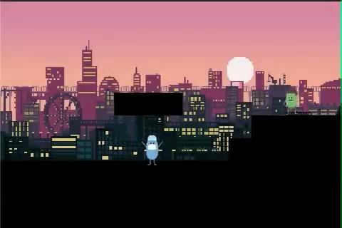
Extra: Adventures Of Masky Gameplay

